Slide 1


Rupal Shah
210002065
EE 304
Notes:
Good Morning Everyone!
We are Team 22 and the solution that we present is TOOLMASTER.

Slide 2


Page 1
INTRODUCTION
Image Encryption and Decryption based on scrambling and the reality-preserving fractional discrete cosine transform
ENCRYPTION
Image encryption is the process of hiding images from unauthorized access using a secret key
DECRYPTION
Decryption means the conversion of encrypted data into its original form is nothing but Decryption.
Fig 1: Google Image
Notes:
So, coming up, we will be covering the following topics.

Slide 3


Page 2
ENCRYPTION ALGORITHM
Image split into respective RGB components
Chirikov chaotic map
X(3m,1) Y(n,1)
Chirikov chaotic map
X(m,1) Y(3n,1)
Images with shifted pixels
Discrete
Cosine
Transform
Arnold Transform
C1
I1
DCT-II
AT
mxn
mxn
Encrypted Image
Image
Horizontal Image
(3mxn)
Vertical
Image
(mx3n)
Image
C1
I2
DCT-II
AT
Image
mxn
mxn
mxnx3
mxm/nxn
C1
column pixel shifted
row pixels shifted
I1
DCT-II
AT
mxn
mxn
Parameters are used in generating the chaos maps and are generated using a hashing algorithm
Notes:
The solution pipeline that we have proposed consists of four blocks. As you can see the four blocks are (pointing at the diagram) RAG Block, Tool Retrieval Block, Tool Selector Block, and Example Generation Block.
The Tool Selector Block uses GPT-4-turbo (pointing) takes in 3 inputs, the user query, a list of relevant tools and top-k examples. The RAG Block outputs the top-k examples. The Tool Retrieval Block which uses GPT-3.5-turbo, reduces the list of given tools and produces the relevant tools required to solve the query. The Example Generation Block which uses GPT-4-turbo plays an important role for dynamic tool handling.
Now, Lets zoom into each block individually.

Slide 4
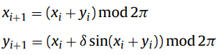

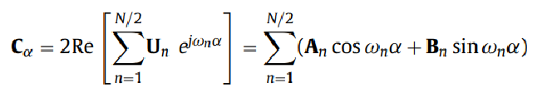
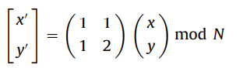
FORMULATION
Page 3
Chirikov Standard Map
Invertible area preserving chaotic map for two canonical dynamical variables from a square with side 2
Fig 2: Research Paper
Discrete Cosine Transform-II
Arnold Transform
The above transforms help to increase the complexity of the encryption and makes it more secure and susceptible to change even on change of parameters in the order of 1e-14.
Fig 2: Research Paper
Notes:
Starting off with RAG Block,
RAG stands for Retrieval Augmented Generation. It consists of a Bi-encoder which generates embedding vectors of the user query and example queries. We then find the top-k example queries most similar to the user query. Then we select the top-k query-answer pairs and feed it in the prompt after re-ranking by the cross encoder to generate the answer.

Slide 5
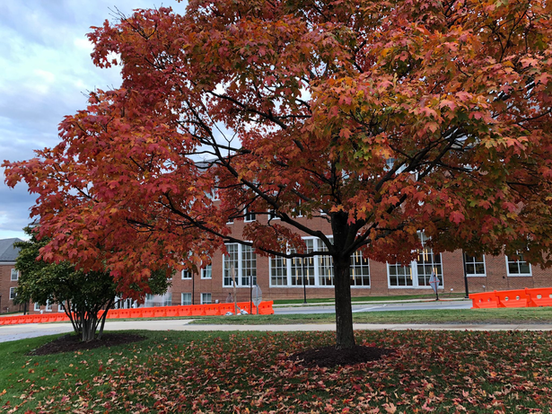
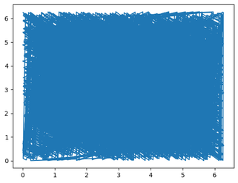
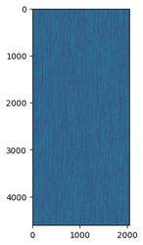
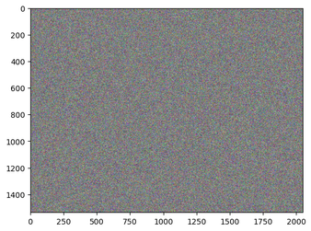
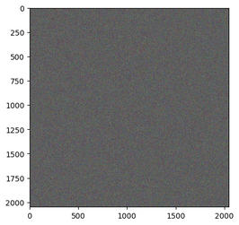
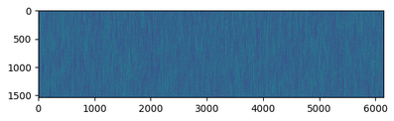
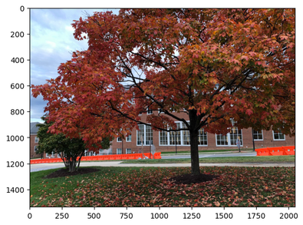
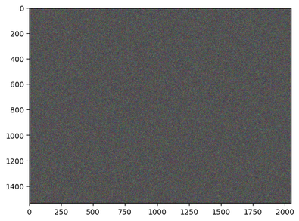
Page 4
Input Image
Chirikov Chaotic map
Vertical shift image
Horizontal shift image
Encryption
DCT-II Encryption
Encryption
Decrypted Image
Decrypted Image with wrong key
RESULTS
Decryption
Notes:
The primary reason for RAG with examples is to provide the most similar and relevant examples in the prompt given a user query.
After giving the examples, the results increased by approx. 39% in comparison to zero shot prompting.

Slide 6
Page 5
RESULTS AND CODE
REFERENCES
1) Research Paper1 - base paper followed
2) Research Paper2 - for arnold transform
3) Research Paper3 - for hashing algorithm
Lossless encryption of images provided a key.
Some novelities implemented are:
Hashing Algorithm to create the encryption key and the parameters.
Extended the algorithm for mxn images instead of square images.
Link for the code
Notes:
After experimentation, we found out that 3 examples give the best results in terms of accuracy, inference, and cost.

Slide 7

THANK YOU

